Slide 1

2026 Korean Society of Remote Sensing Fall Conference
Robustness Benchmarking of Lightweight Detectors for Bangladeshi License Plate Detection Under Adverse Weather Conditions
Hasan Md Ariful | Supervisor: Pham Trung Hieu
Department of Global IT Engineering, Kyungsung University, Busan, Republic of Korea

Slide 2
Table of Contents
1
Problem and motivation
2
Method
Why weather breaks plate detectors in Bangladeshi traffic.
Dataset, degradation protocol, three detectors.
3
Mitigation strategies
4
Results and takeaways
Baseline, CLAHE+Gamma restoration, augmented retraining.
Accuracy, latency, qualitative evidence, decision guidance.
2

Slide 3
Motivation
Why weather robustness matters for LPR
Research Gap
• Monsoon rain, dense fog, and poor night lighting are frequent in South Asian cities, yet most public LPR benchmarks use clear daylight data.
• Bangladesh gets over 2,500 mm of annual rainfall plus extended winter fog.
• Plates are small, texture-dense targets. Likely because fog and darkness remove the fine edges needed for localization.
• Edge devices such as Jetson Nano or Raspberry Pi 4 limit model size and latency.
No prior work benchmarks weather robustness for Bangladeshi plates or compares classical restoration with augmentation for edge deployment.
Contributions
6-condition degradation protocol
Cross-architecture validation
Restoration vs. augmentation
Practitioner decision framework.
3

Slide 4
Method Overview
Experimental pipeline
1 Dataset
1,929 plate images Dhaka traffic
2 Split
80 / 20
1,543 train
386 validation
3 Weather synthesis
Augmentation rain, fog, low-light (6 cond.)
4 Detectors
YOLOv8-nano
YOLOv5-nano
MobileNet-SSD
5 Strategies
Baseline
CLAHE+ augmentation
6 Evaluation
mAP@50/ 50-95
Latency(FP16)
Bootstrap test
All models trained for 50 epochs at 640 x 640, batch size 16, AdamW with cosine-annealed learning rate (lr = 0.01), seed 42.
Each validation image is evaluated clean plus five degraded variants: rain (light/heavy), fog (light/heavy), low-light.
4

Slide 5
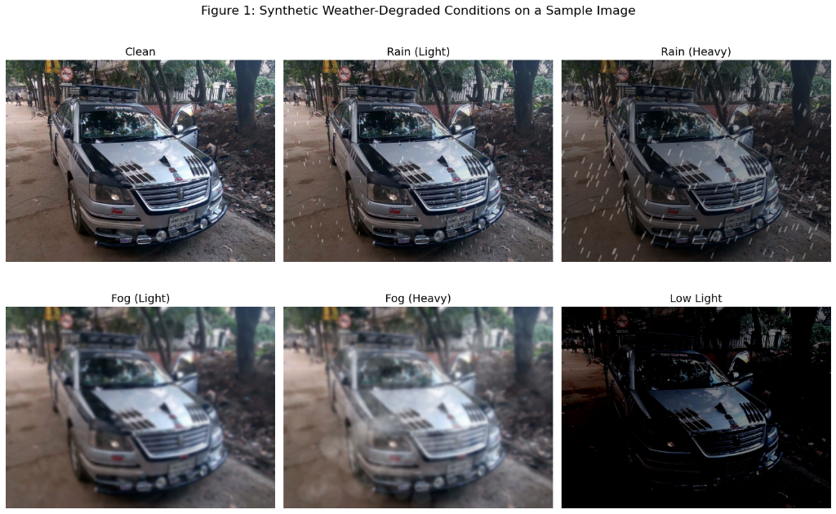
Dataset And Degradation
Synthetic weather on real Bangladeshi plates
1,929
1,543/386
annotated images
train / val
6
9,258
conditions
augmented train set
Condition | Transform | Key parameters
Rain-light | RandomRain | drop_len=20, blur=3
Rain-heavy | RandomRain | coef 0.1-0.3
Fog-light | RandomFog | coef 0.1-0.3
Fog-heavy | RandomFog | coef 0.4-0.6
Low-light | RandomGamma | gamma 15-50
Fig. 1 : clean, rain, fog, and low-light conditions on one sample. Dataset: Khan (2024), Kaggle.
5

Slide 6
Detectors
Three lightweight architectures
Input
Backbone
Neck
Detection head
YOLOv8-nano
3.02M params
8.2 GFLOPs
X 640
image
CSP backbone
With C2f blocks
PAN-FPN
Multi-scale fusion
Decoupled head
Anchor-free
-> Plate box + score
YOLOv5-nano
1.9M params
4.5 GFLOPs
X 640
image
CSPDarknet
backbone
PANet
feature fusion
Coupled head
Anchor-based
-> Plate box + score
MobileNet-SSD
3.2M params
2.4 GFLOPs
X 640
image
MobileNet backbone
(depthwise separable)
Extra
feature layers
SSD multi-scale
-> Plate box + score
6

Slide 7
Mitigation Strategies
Pay at inference time or at training time?
Training data
Training
Test input
Preprocessing
Output
Baseline
1,543 clean images
Train
YOLOv8-nano
Degraded
validation image
None
Plate boxes
+
Condition
Classical restoration
1,543 clean images
Train
YOLOv8-nano
Degraded
validation image
CLAHE + gamma
+12.3 ms / image
Plate boxes
+
Condition
Weather-augmented retraining
Clean + 5 weather
Copies (9,258)
Retrain
YOLOv8-nano
Degraded
validation image
None
(no overhead)
Plate boxes
+
Condition
Restoration needs no retraining but adds CLAHE 8.1 ms + gamma 4.2 ms per frame. Augmented retraining adds no inference cost but needs roughly 6x the training data and a full retrain.
7

Slide 8
Baseline Results
Fog and low-light hurt far more than rain
-12.0 pp
low-light: 0.978 to 0.858
-10.3 pp
heavy fog: 0.978 to 0.876
Likely because rain preserves overall scene contrast, while fog and darkness suppress fine edge information.
Y-axis starts at 0.80 for readability. Clean mAP@50-95 = 0.603.
8

Slide 9
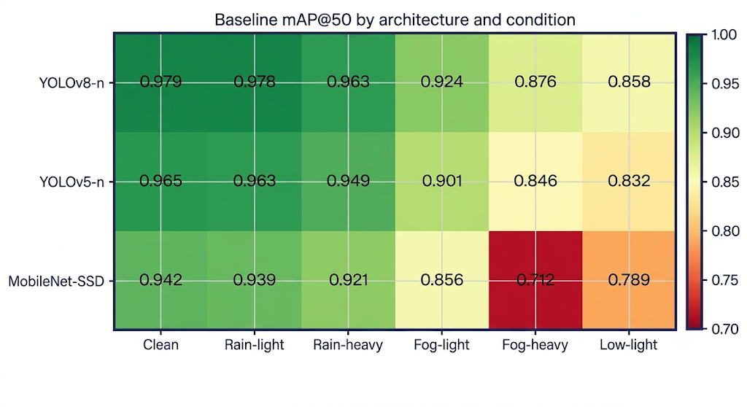
Cross-architecture
Degradation pattern generalizes across detectors
mAP@50 heatmap: architecture × condition
Condition | YOLOv8-n | YOLOv5-n | MobileNet-SSD
Clean | 0.9785 | 0.9654 | 0.9421
Rain-light | 0.9781 | 0.9632 | 0.9387
Rain-heavy | 0.9627 | 0.9489 | 0.9213
Fog-light | 0.9236 | 0.9012 | 0.8564
Fog-heavy | 0.8758 | 0.8456 | 0.7123
Low-light | 0.8581 | 0.8321 | 0.7894
KEY OBSERVATIONS
YOLOv8-nano is best in every condition (green).
MobileNet-SSD drops to 0.712 in heavy fog, the steepest collapse (orange).
Its shallower feature pyramid appears more vulnerable to contrast suppression.
9

Slide 10
Mitigation Results
Augmented training closes most of the gap
0.876 → 0.951
heavy fog: baseline to augmented
0.858 → 0.936
low-light: baseline to augmented
0.891
heavy fog with CLAHE+Gamma only
mAP@50 for baseline, restored, and weather-augmented YOLOv8-nano. Y-axis starts at 0.80.
10

Slide 11
Mitigation Results
Strategy comparison (YOLOv8-nano, mAP@50)
Condition | Baseline | Restoration | Augmented | Aug. gain (pp) | Gap recovered
Clean | 0.9785 | 0.9791 | 0.9802 | +0.17 | -
Rain-light | 0.9781 | 0.9772 | 0.9808 | +0.27 | -
Rain-heavy | 0.9627 | 0.9694 | 0.9756 | +1.29 | 82%
Fog-light | 0.9236 | 0.9302 | 0.9536 | +3.00 | 55%
Fog-heavy | 0.8758 | 0.8909* | 0.9513* | +7.55 | 74%
Low-light | 0.8581 | 0.8976* | 0.9356* | +7.75 | 64%
* p < 0.05 (bootstrap resampling, n = 1000) vs. baseline.
Gain = augmented minus baseline; gap recovered = gain divided by the clean-to-baseline drop. Computed from the table values.
11

Slide 12
Latency and Ablation
Restoration helps, but at a throughput cost
+12.3 ms
45.2 FPS
35.8 FPS
added latency
baseline (Jetson Nano FP16)
with restoration
CLAHE contributes 8.1 ms and gamma 4.2 ms; augmented training adds no inference overhead.
CLAHE helps most in low light, gamma helps most in fog; combining both is best (about 15% of the heavy-fog gap and 33% of the low-light gap).
Restoration ablation (Table 4). Y-axis starts at 0.84.
12

Slide 13
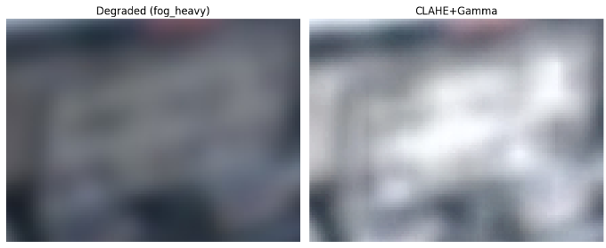
Qualitative Analysis
Restoration raises confidence on a heavy-fog sample
Fig. 3 : degraded input, CLAHE+Gamma restoration, and Unsharp+Wiener deblurring.
0.56 → 0.71
Same model weights, only the input changed: inference-time restoration alone can lift detector confidence on hard cases.
plate confidence after CLAHE+Gamma
13

Slide 14
Conclusions
Decision guide for edge deployment
Can retrain?
Cannot retrain?
Architecture
Use weather-augmented training: best robustness, zero inference overhead.
Use CLAHE+Gamma restoration: partial recovery, +12.3 ms per frame.
YOLOv8-nano is the most weather-robust; MobileNet-SSD is most fragile in fog.
Heavy fog mAP@50: 0.876 baseline → 0.891 restoration → 0.951 augmented
Limitations and Future Work
Synthetic weather is a proxy and the sim-to-real gap is unquantified. Next: a real adverse-weather dataset, lightweight learned restoration, and matra-aware character recognition for end-to-end LPR.
14

Slide 15
Thank you
Questions and discussion
Hasan Md Ariful | Pham Trung Hieu | Kyungsung University

